Slide 1
Characteristics of ionospheric responses to solar flares observed by the SuperDARN Hokkaido radar
Photo: 2011/04/15 05:15 AM
Nozomu Nishitani¹, Tadahiko Ogawa², Takashi Kikuchi¹, Tomoaki Hori¹, and SuperDARN Hokkaido radar group
1. STEL/ Nagoya Univ. 2. NICT
Notes:
1

Slide 2
Contents:
Overview of solar flare effects
Event analysis (15 Feb. 2011)
Multievent analysis
Discussion and summary
Notes:
2

Slide 3
Dellinger phenomena
X
X
X
Unusual ionization of D-region ionosphere
Absorption of HF waves by unusually ionized D-region ionosphere due to X-ray radiation from the solar flares
Can be also called: Short-wave fadeouts (SWF), solar flare effects (SFE) etc.

Slide 4
Sunspot number variation since 1750
SuperDARN Hokkaido radar full operation (2006.12-)

Slide 5
Feb 13-15, 2011 (X2.2 flare)

Slide 6
SuperDARN observation of solar flare effects
The radar observed fadeout of HF echoes following the X2 .2 flare which started on 2011/02/15, at 0144 UT (max: 0156 UT, end: 0206 UT)

Slide 7
4 years ago
Short wave fadeout (SWF) event on 2006/12/13, at 0214 UT due to X 3.4 flare (max: 0240 UT, end: 0257 UT)

Slide 9
Hosokawa et al. (2000, APUAR) GOES, EISCAT, IMAGE MAG, GRNLND MAG, SuperDARN (Iceland West)

Slide 10
2011/02/05 00-04UT echo power

Slide 11
2011/02/15 00-04 UT vel

Slide 12
2011/02/15 00-04 UT vel (expand.)

Slide 13
Ground / sea scatter echoes

Slide 14
Vel 0147-0152 UT

Slide 15
Vel 0204-0219 UT

Slide 16
Elevation angle of echo can be calculated from the phase difference between main and interferometer arrays
Path difference=2*d * cos (elev.)
For SuperDARN d is usually longer than radar wavelength, so that there are 2πn ambiguities.
elev.
Sub array
Main array
d=100 m (Hokkaido radar)

Slide 17
2011/02/15 00-04 UT elev

Slide 18
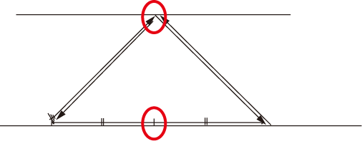
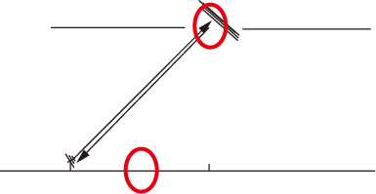
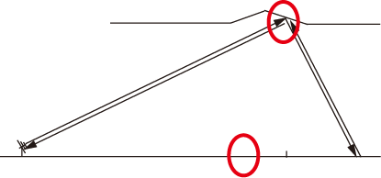
Ground scatter echo geometry
ionosphere
ground
Plotting position
Plotting position
Plotting position
Horizontal inhomogeneity change the elevation angle
distribution for fixed ranges as well as plotting positions

Slide 19
Flare pickup (Hokkaido radar in the dayside: 22-07 UT, X/M flares, Dec. 2006-Feb. 2011)
2006
12/06 0130 M1.1
12/13 0214 X3.4
2007
06/01 0646 M1.0
06/03 0151 M2.4
06/03 0206 M7.0
06/03 0636 M4.4
06/04 0506 M8.9
2008
2009
2010
02/07 0220 M6.4
06/12 0057 M2.0
06/13 0530 M1.0
11/04 2330 M1.6
2011
01/28 0044 M1.3
02/09 0123 M1.9
02/15 0144 X2.2
02/16 0132 M1.0

Slide 20
2006/12/13 start: 0214 UT max: 0240 UT end: 0257 UT X3.4 flare

Slide 21
2010/02/07 start: 0220 UT max: 0234 UT end: 0239 UT M6.4 flare

Slide 22
2011/02/09 start: 0123 UT max: 0131 UT end: 0135 UT M1.9 flare

Slide 23
2011/02/16 start: 0132 UT max: 0139 UT end: 0146 UT M1.0 flare

Slide 24
Any changes in echo power / velocity? (Hokkaido radar in the dayside: 22-07 UT, X/M flares, Dec. 2006-Feb. 2011)
2006
12/06 0130 M1.1 yes
12/13 0214 X3.4 yes
2007
06/01 0646 M1.0 yes
06/03 0151 M2.4 yes
06/03 0206 M7.0 yes
06/03 0636 M4.4 yes
06/04 0506 M8.9 yes
2008
2009
2010
02/07 0220 M6.4 yes
06/12 0057 M2.0 yes
06/13 0530 M1.0 yes
11/04 2330 M1.6 yes
2011
01/28 0044 M1.3 yes
02/09 0123 M1.9 yes
02/15 0144 X2.2 yes
02/16 0132 M1.0 yes

Slide 25
2007/05/02 start: 2328 UT max: 2348 UT end: 0002 UT C8.5 flare

Slide 26
2007/07/10 start: 0329 UT max: 0333 UT end: 0343 UT C4.4 flare

Slide 27
Tsugawa et al. (JGR, 2006) solar zenith angle dependence of TEC increase due to solar flares (with summer-winter asymmetry, probably due to difference in chemical reaction rates)

Slide 28
Summary
SuperDARN Hokkaido radar observed short-wave fadeout phenomenon following X 2.2 flare on 15 Feb 2011.
The radar observed positive Doppler velocities of ground / sea scatter echoes just before the disappearance of echoes, indicating unusual ionization of F-region ionosphere due to solar-flare EUV. It also observed negative velocities just after the echo reappearance.
Disappearances of ground scatter echoes are homogeneous, whereas echo reappearance begins with near range and farther ranges later. In addition elevation angle distribution doe not change during disappearance but it changes during recovery, which suggest horizontal inhomogeneity in recombination processes.
X3.4 flare on 13 Dec 2006 also shows same characteristics.
Not-only X-class but also M-class (and even some C-class) flare show same characteristics (echo disappearance / decay and Doppler velocity changes). Multievent analysis seems to show dependence on solar zenith angle as well as flare intensity.
Even if you see sudden echo disappearance, don’t panic! You may be seeing very interesting natural phenomena.

Slide 29
Future works
Statistical relationship between flare intensity and echo disappearances / decays
Dependence on solar zenith angle / season
Detailed characteristics of spatial / temporal changes of echo power, Doppler velocity and elevation angle
Analysis of events during frequency-scan modes

Slide 30
2011/03/23 SuperDARN Hokkaido radar quicklook (frequency scan) start: 0203 UT M1.4 flare

Slide 31
2011/03/23 SuperDARN Hokkaido radar (frequency scan) start: 0203 UT M1.4 flare pwr_l & vel

